Slide 1
Our Approach to Media for X Fold3

Slide 2

01 | Brief Recap & our Understanding
02 | Audience understanding
03 | Media consumption & Behaviour
04 | Media Approach
05 | Innovations
Today’s agenda

Slide 3
X Fold3 Audience understanding

Slide 4
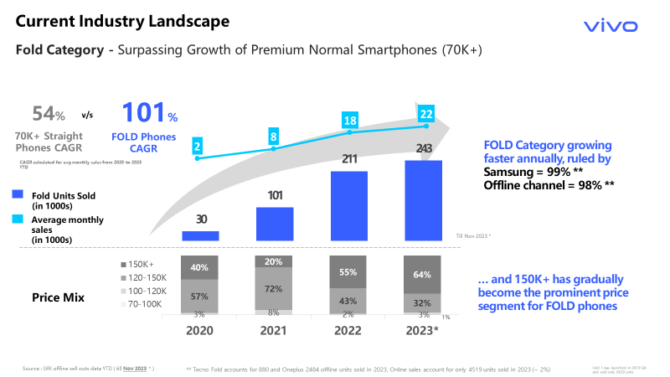
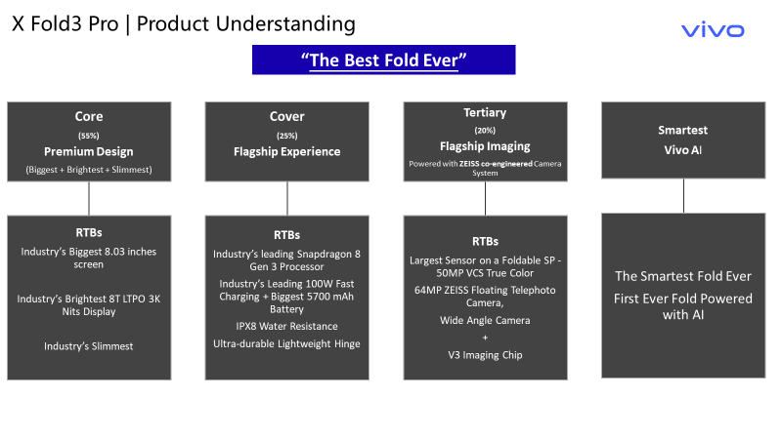
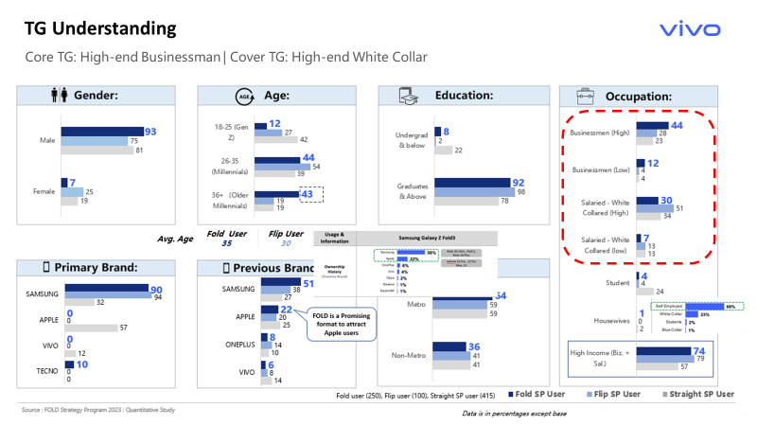
1. Key takeaways from X Fold3 Brief
Challenges:
Entering market dominated by primary competition
Battling Perception of Premium imaginary leading to durability
Communication
“THE BEST FOLD EVER”
Premium Design
Durability
vivo AI
Zeiss Integration
Target Group
Age Group: 30 – 45
Affluent Professional
Previous Brand: Samsung, Apple & OnePlus
Prefer higher Brand Imagery
Interests: Luxurious lifestyle, Travel, Technology & Premium Brands

Slide 5
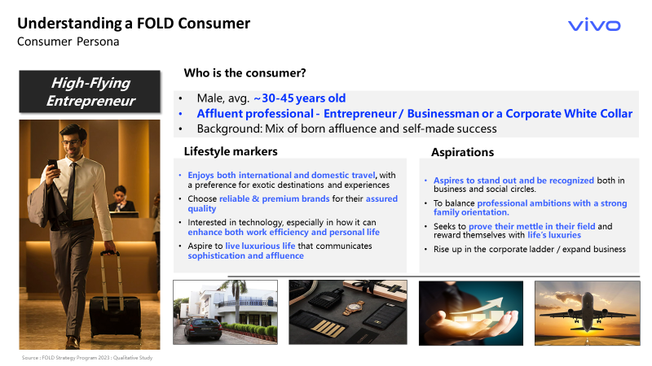
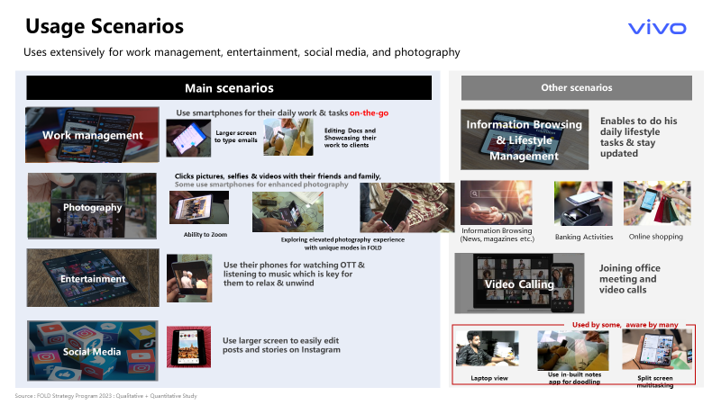
Audience input derived from the brief
COVER AUDIENCE
Interested in MOBILE Phones
Primary Audience
CORE AUDIENCE
X & V Pro Series users
Apple/Samsung/OP users
Luxurious lifestyle, Travel, Technology & Premium Brands

Slide 6






Audience planning process for X Fold3
Integrated Audience Understanding
Tool driven Planning
Touch point selection
Media Planning
Demographic understanding
Physiographic understanding
Integrated Planning
Integrated Budgeting
Site Selection
Apps Selection
First level
Detailing
In market and Affinity
Architect
Predecessors' learnings
Predecessors' learnings
To get the right audience insights we looked at the appropriate relevant products available : Insight finder: X90 and X80 along with OP 10PRO (11PRO NA) & Samsung Galaxy S23 are available in Google Insights Finder
GWI : Samsung S series
Launch days for reference
OnePlus Sale Date 31st Mar 2022
X80 Launch Date 25th Apr 2022
X90 Launch Date 26th Apr 2023
S23 Launch Date 1st Feb 2023

Slide 7
Key Traits of X Series Purchase intenders
based on overlap between 1PD & 3P DMP audience
Top 3P DMP Audience Cohorts (basis share) | Overlap | Share | Index
Budget Traveller | 14,804 | 40% | 1.565
International Traveller | 15,400 | 42% | 1.560
Statement: “Electric Cars are the future” | 14,415 | 39% | 1.541
Finance News | 9,430 | 25% | 1.537
Statement: “Early Adopter of New Technology” | 17,996 | 49% | 1.528
Luxury Cars | 8,782 | 24% | 1.516
Job Profile : Business Development | 16,094 | 43% | 1.277
Business Intelligence | 17,787 | 48% | 1.158
Enterprise Business Solutions (EBS) | 19,975 | 54% | 1.109
Tech / IT Business Professionals | 13,422 | 36% | 1.008
Job Seniority : CXO | 15,559 | 42% | 1.135
Job Seniority : Head | 14,423 | 39% | 1.289
High disposable income | 19,097 | 52% | 1.037
Millennial | 23,245 | 63% | 1.283
Considering most likely purchasers for vivo X Fold3 being vivo Flagship Loyalists with following traits:
International Travel Enthusiasts
High Disposable income
Affinity towards Luxury Cars & Watches
Senior level Job Designation
Affinity towards APPLE devices
Business Professional – Enterprise
Affinity towards Motor Vehicles
Top 3P DMP Audience Cohorts (basis index) | Overlap | Share | Index
In Market for Fitness Watch | 2,135 | 6% | 2.349
In Market Used Cars | 2,635 | 7% | 2.166
Affinity towards Apple Devices | 3,034 | 8% | 2.139
In Market - Luxury Watches | 2,349 | 6% | 2.120
In Market for Home Theatre Systems | 6,162 | 17% | 1.916
In Market for Camera | 7,211 | 19% | 1.909
In Market for Motorcycles | 7,086 | 19% | 1.873
Researching for vehicle Specs & Reviews | 9,298 | 25% | 1.871
Business Professional | 9,771 | 26% | 1.911
Source :
DV360 Audience Analysis: Seed Audience - Buynowclick - Purchase Intent_X Series (Audience size 39,000)
Data Partners - Semasio | Liveramp | Eyeota | YouGov

Slide 8
Architect defines our TG as Millennials with almost equal gender split..
Source : Choreograph: Audience Origin 2.x (BETA) Description: Travelled abroad at least once in last 12 months OR Department Manager/VP and above OR Annual income 15 Lacs & above

Slide 9
..career focused, at a life stage to get married and invest in high ticket item purchases
Source : Choreograph: Audience Origin 2.x (BETA) Description: Travelled abroad at least once in last 12 months OR Department Manager/VP and above OR Annual income 15 Lacs & above

Slide 10
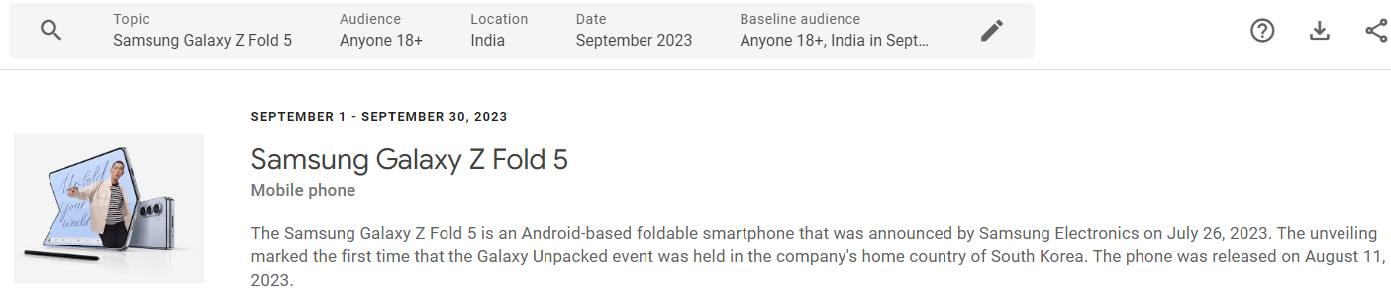
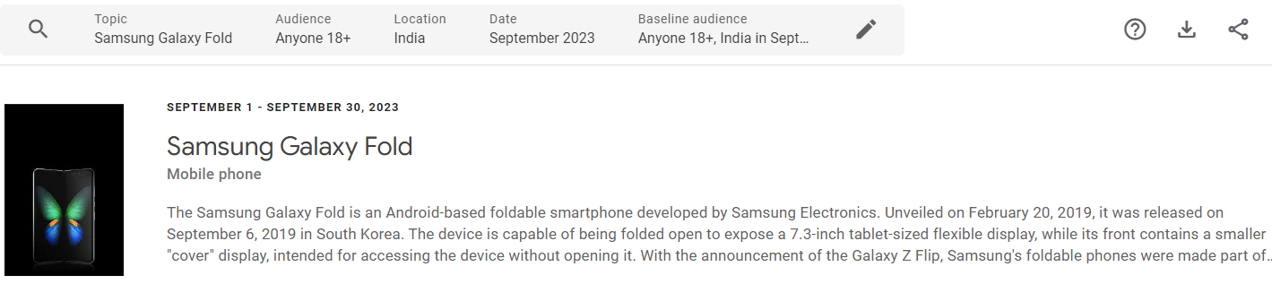
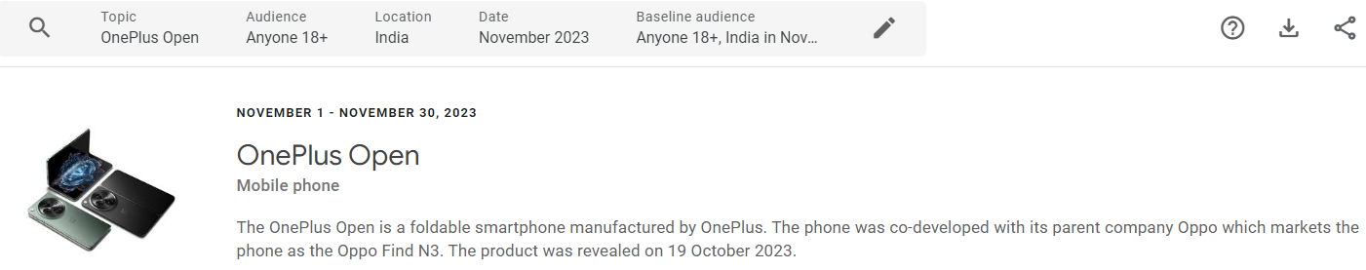
“Millennials” clearly define our core TG with Females contributing towards a substantial share
Insights Finder
Samsung Galaxy Z5
Gender | Share | Index | Relevance
Male | 67% | 1.02 | 1
Female | 33% | 0.97 | 0.78
Samsung Fold
Gender | Share | Index | Relevance
Male | 67% | 1.01 | 1
Female | 33% | 0.98 | 0.8
OnePlus Open
Gender | Share | Index | Relevance
Male | 84% | 1.28 | 1
Female | 16% | 0.46 | 0.29
Samsung Galaxy Z5
Age | Share | Index | Relevance
18-24 | 31% | 1 | 0.63
25-34 | 23% | 0.66 | 0.43
35-44 | 38% | 1.78 | 1
45-54 | 6% | 0.67 | 0.28
Samsung Fold
Age | Share | Index | Relevance
18-24 | 29% | 0.98 | 0.62
25-34 | 23% | 0.67 | 0.45
35-44 | 38% | 1.74 | 1
45-54 | 6% | 0.75 | 0.32
OnePlus Open
Age | Share | Index | Relevance
18-24 | 46% | 1.5 | 1
25-34 | 30% | 0.85 | 0.6
35-44 | 19% | 0.91 | 0.54
45-54 | 5% | 0.61 | 0.27
Source : Google Insights Finder, India, Sept-Nov 23,: - Topic – OnePlus Open| Samsung Fold | Samsung Galaxy Z5

Slide 11
Our TG is invested in emerging tech & high-ticket items
Source : GWI, Wave Q1 2023 – Q4 2023: Question: Which of these products have you or your household purchased in the last 3-6 months? Which of these items did you purchase online? Which of these items are you / your household thinking about purchasing in the next 3-6 months?
Question: In the last week, which of these have you watched, listened to, or done online?
vivo X Series - Travelled abroad at least once in last 12 months OR Department Manager/VP and above OR Annual income 15 Lacs & above Samsung Z Fold: Owns/used to own Samsung Galaxy Z Fold 4

Slide 12
is tech friendly, with higher use of voice assistant tech
Source : GWI, Wave Q1 2023 – Q4 2023: Question: Which of these products have you or your household purchased in the last 3-6 months? Which of these items did you purchase online? Which of these items are you / your household thinking about purchasing in the next 3-6 months?
Question: In the last week, which of these have you watched, listened to, or done online?
vivo X Series - Travelled abroad at least once in last 12 months OR Department Manager/VP and above OR Annual income 15 Lacs & above Samsung Z Fold: Owns/used to own Samsung Galaxy Z Fold 4

Slide 13
Addressing the requirements
vivo X Series TG & Samsung Z Fold users are Open minded and majority share can be defined as:
Open to try new things
Influenced by Ads
Likes to take risks
Prefer Premium Products
Opinion Leaders
Like being represented by community
Affluent
Values being successful
Comfortable with data sharing policies
Source : GWI, Wave Q1 2023 – Q4 2023: vivo X Series - Travelled abroad at least once in last 12 months OR Department Manager/VP and above OR Annual income 15 Lacs & above Samsung Z Fold: Owns/used to own Samsung Galaxy Z Fold 4

Slide 14



Key TG takeaways & recommendations for vivo X Fold3
Demo & Audience understanding, Interests & Behaviors
Physiographic understanding
Audience understanding 1PD vs. 3P DMP overlap
Demo 30-54 YOA, Consistent Male Dominance, & Higher Female Engagement
In Market Gaming Peripherals & Accessories, Primary & Secondary Schools (K-12), SUVs (New), , Luxury Vehicles,
Affinity Shopping Enthusiasts, Performance & Luxury Vehicle Enthusiasts, Motor Sports Enthusiasts,
Top Attributes -
Open to try new things
Influenced by Ads
Likes to take risks
Prefer Premium Products
Opinion Leaders
Like being represented by community
Affluent
Values being successful
Demo - Millennials, College graduates Similar Male & Female split.
Key Traits
International Travel Enthusiasts
High Disposable income
Affinity towards Luxury Cars & Watches
Senior level Job Designation
Affinity towards APPLE devices
Business Professional – Enterprise
Affinity towards Motor Vehicles
Key Takeaways and Recommendations For X Fold3
Demo, Interests, Affinities
Geography
Demo – 30- 54
CORE TG: Gaming Peripherals & Accessories, Mobile Phones, Primary & Secondary Schools (K-12), SUVs (New), Luxury Vehicles, Luxury Travelers, Shopping Enthusiasts, Performance & Luxury Vehicle Enthusiasts, Motor Sports Enthusiasts, Snowbound Travelers, International Travelers
COVER TG: Mobile Phones, Mobile Enthusiasts
HHI Targeting – Top 30%
CORE TG: Explained in below slides
COVER TG: PAN INDIA

Slide 15

Our Core TG is highly Digitally Active, but they also spend a fair share of time on TV and Print
Online Press
Less than30 mins
(28.4% | 95.3 ix)
Physical Press
30 mins to 2 hours
(27.1% | 140.7 ix)
Less than 30 mins :
Online Press
Linear / Broadcast TV
30 mins to 2 hours
(55.7% | 135.4 ix)
More than 4 hours :
Laptop or PC
Online on PC / Laptop / Tablet More than 4 hours
(29.2% | 115.4 ix)
Social Media
30 mins to 2 hours
(43.9% | 111.4 ix)
Podcasts
30 mins to 2 hours
(31.5% | 146.3 ix)
Online TV / Streaming
30 mins to 2 hours
(41.1% | 122.3 ix)
30 mins to 2 hours :
Linear TV
Social Media
Online TV
Music Streaming
Gaming
Radio
Podcasts
Physical Press
Connected TV < & OTT
Radio
30 mins to 2 hours
(31.9% | 139.9 ix)
2 to 4 hours :
Online Mobile
Online on Mobile
2 hours to 4 hours
(38.1% | 124.9 ix)
Music Streaming
30 mins to 2 hours
(35.8% | 122.1 ix)
Games Consoles
30 mins to 2 hours
(35.7% | 147.8 ix)
> Connected TV
Core Target is consuming
DIGITAL
Mobile first, followed by PC
Social Media,
OTT, C TV
Music Streaming + Podcasts
OFFLINE
Linear / Broadcast TV
Physical Press (Print)
Source : GWI, Wave Q1 2023 – Q4 2023: vivo X Series - Travelled abroad at least once in last 12 months OR Department Manager/VP and above OR Annual income 15 Lacs & above
Notes:
X Series audiences are Mobile first, with Internet keeping them engaged & entertained. OLV & OTT platforms become critical to reach out to these audiences

Slide 16
with high Affinity Index, towards Gaming, Print, TV & Online Video Ads
So, given this the management in China to understand the
1. The slide shared wisely justified digital and its landscape. Only thing we need to add here is top targeting apps/platform like gaming is a big genre so is entertainment. Hence request you to call out 5-7 top apps in each of the genres.
2. We see a fair opportunity to put a case for TV, print, D/OOH & cinema. I see music streaming a surrogate of Radio..
Suggest if we have 1-2 slide which describes CDJ of premium consumer including all media (offline and online).
For offline if we have recommendations like:
TV (sports HD, other surrogate)
Ooh (airport etc)
DOOH ( premium malls , society etc)
Cinema ...
Channel selection should be integrated & cover all media vehicles including TV & Print along with Digital Ads
Target audience have shown higher affinity Index towards:
Gaming Ads, Pre-Roll video Ads
Print & TV Ads
Review websites (Gadgets 360 / 91 mobiles), Retail websites (Amazon / Flipkart).
Source : GWI, Wave Q1 2023 – Q4 2023: vivo X Series - Travelled abroad at least once in last 12 months OR Department Manager/VP and above OR Annual income 15 Lacs & above Samsung Z Fold: Owns/used to own Samsung Galaxy Z Fold 4

Slide 17
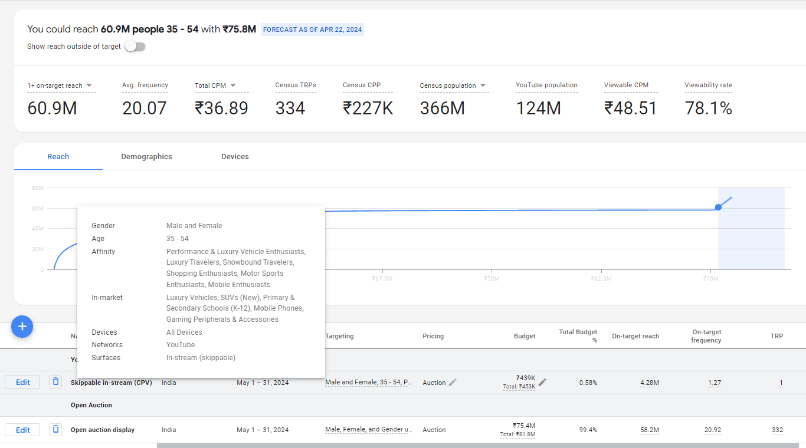
Sizing the Potential of our TG – Option 3 – Targeting only Core
Budget- 8Cr
CORE TG
35-54, M&F,
Gaming Peripherals & Accessories, Primary & Secondary Schools (K-12), SUVs (New), Luxury Vehicles, Luxury Travelers, Shopping Enthusiasts, Performance & Luxury Vehicle Enthusiasts, Motor Sports Enthusiasts, Snowbound Travelers, International Travelers
79.2* Mn
35-54, Males + Female, PAN India
158* Mn
Source : DV360 Reach Planner, YouTube + Display India, Target Reach at 1+ | India * Overall reach planned= 60.9*30%(duplication of platforms)

Slide 18
Budget Distribution across channels – Option 3 – Targeting only Core
X Fold3 | Budget
Online Search | 15,000,000
Social Media | 14,100,000
Online Video Auction | 19,000,000
Display Auction | 4,500,000
Online Video Reserve Buy | 5,500,000
Display Reserve Buy | 18,000,000
Concurrency & Webcasting | 1,620,000
Ad Serving & Agency Fees | 2,280,000
Total | 80,000,000
Higher investments in Display & Video Auction buys due to Narrower Audience (Option3)
Basic Investment of 1.5 Cr on search would Cater towards Brand & Generic segments.
Conservative spends on Display & Video reserve considered for hygiene properties (Tech pack, Mastheads & Tech + Lifestyle websites) to create impact on Launch & Superday – Limited spends on DOOH

Slide 19
Channel Split Comparison - X100 TG vs Option 3 TG
X100 | Budget | Share
Online Search | 30,123,460 | 20%
Social Media | 35,361,764 | 24%
Online Video Auction | 33,371,655 | 23%
Display Auction | 8,381,483 | 6%
Online Video Reserve Buy | 13,823,498 | 9%
Display Reserve Buy | 19,902,515 | 14%
Concurrency & Webcasting | 1,620,000 | 1%
Ad Serving & Agency Fees | 4,403,140 | 3%
Total | 146,987,515 | 100.00%
X Fold3 | Budget | Share
Online Search | 15,000,000 | 19%
Social Media | 14,100,000 | 18%
Online Video Auction | 19,000,000 | 24%
Display Auction | 4,500,000 | 6%
Online Video Reserve Buy | 5,500,000 | 7%
Display Reserve Buy | 18,000,000 | 23%
Concurrency & Webcasting | 1,620,000 | 2%
Ad Serving & Agency Fees | 2,280,000 | 3%
Total | 80,000,000 | 100.00%
Compared to X100, for vivo X Fold3 we have:
Higher investment share on Display Reserve to create Impact on Launch & Super Day via RB properties & ROS Innovations.
Increased share on Video Auction slightly to generate higher intended views
Reduced budgets on Display & Social auction due to narrower TG
Investments on Search lowered slightly due to limited Searches in “Fold” category

Slide 20
Reach & Frequency dispersion - Option 3 (8 Cr) Forecasting 5+ Unique Reach of 36Mn+ for X Fold3

Slide 21
Budget Phasing - Option 3 8Cr (8 Cr)
X Fold3 | PRE-BUZZ | LAUNCH | PREBOOK | SUPER DAY | SUSTENANCE
Campaign Dates | 20th May - 5th Jun | 6th Jun | 7th Jun - 12th Jun | 13th Jun | 14th June - 30th June
No. of Days | 17 | 1 | 6 | 1 | 17
Budget Share | 30% | 24% | 26% | 9% | 11%
Budget | 2.4 Cr | 1.9 Cr | 2.1 Cr | 0.7 Cr | 0.9 Cr
Per Day Spends | 14 L | 1.9 Cr | 35 L | 0.7 Cr | 5 L
Audiences | Core | Core | Core + Remarketing | Focus on Core + Limited Remarketing | Remarketing Only
TG | PAN INDIA | PAN INDIA | PAN INDIA | PAN INDIA OR TOP CITIES (where Fold would be available) | PAN INDIA OR TOP CITIES (where Fold would be available)

Slide 22
X Fold3 Tentative KPIs
Metric | X80 | X90 | X100 | Tentative KPI Deliverables | %delta compared to X100
Budget | 110,600,000 | 113,600,000 | 137,076,860 | 75,742,978 | -45%
Impressions | 1,889,000,000 | 2,892,000,000 | 3,873,805,004 | 1,537,499,708 | -60%
Clicks | 18,800,000 | 14,200,000 | 26,363,107 | 9,882,374 | -63%
Views | 396,000,000 | 343,000,000 | 547,613,958 | 318,027,879 | -42%
CTR | 1.00% | 0.49% | 0.68% | 0.64% | -5%
ECPM | 59 | 39 | 35 | 49 | 41%
ECPV | 0.28 | 0.33 | 0.25 | 0.24 | -5%
ECPC | 5.88 | 8.0 | 5.2 | 7.7 | 47%
Channel | eCPM | eCPM variation vs X100 | eCPM X Fold3 Actual | eCPM variation vs X100 Actual | Remarks
 | X100
Online Search | 4,009 | 22% | 4,916 | 23% | Higher investments on Competition segment
Social Media | 21 | 65% | 25 | 19% | Higher investments on Instagram Placement
Online Video Auction | 41 | 47% | 57 | 39% | Higher investments on CPV buy properties for Maximizing views
Display Auction | 8 | 157% | 16 | 104% | Low eCPM properties like Truecaller/Sharechat/Moj/Casual Gaming inventories to be excluded
Online Video Reserve Buy | 120 | 10% | 187 | 56% | Higher investments on high SOV properties (YT select packs) compared to Google/CTV Masthead
Display Reserve Buy | 64 | 135% | 75 | 17% | Inclusion of DOOH & premium placments
Total | 35 | 95% | 52 | 49% | -
Only media metrics considered. (Ad Serving, Agency Fees, Concurrency & Webcast are not included)

Slide 23
X Fold3 Tentative QV Trend
X Fold 3 Launch
X Fold 3
Superday
Prebuzz
Sustenance phase

Slide 24
Search Prioritize targeting competition to capture existing searches
*Competition P1
Capture Market Share
Drive Consideration
Brand (incl. Brand Others) P3
Protect Brand Real Estate
*Generic P2
Improve Brand visibility
Uplift Brand Core Searches
*Competition- Samsung, OP, iPhone
*Generic- All foldables and ASP 70K+

Slide 25
Display & Video Auction Approach
TARGETING STRUCTURE
Video Auction (55%)
Display Auction (20%)
Remarketing (25%)
YouTube (Audience)
CTV (Placement)
Audience
Placement
Display
YouTube
YT
YT + OTT
Standard Banners
Rich media Banners
Reach Builder
Frequency Builder

